Slide 1
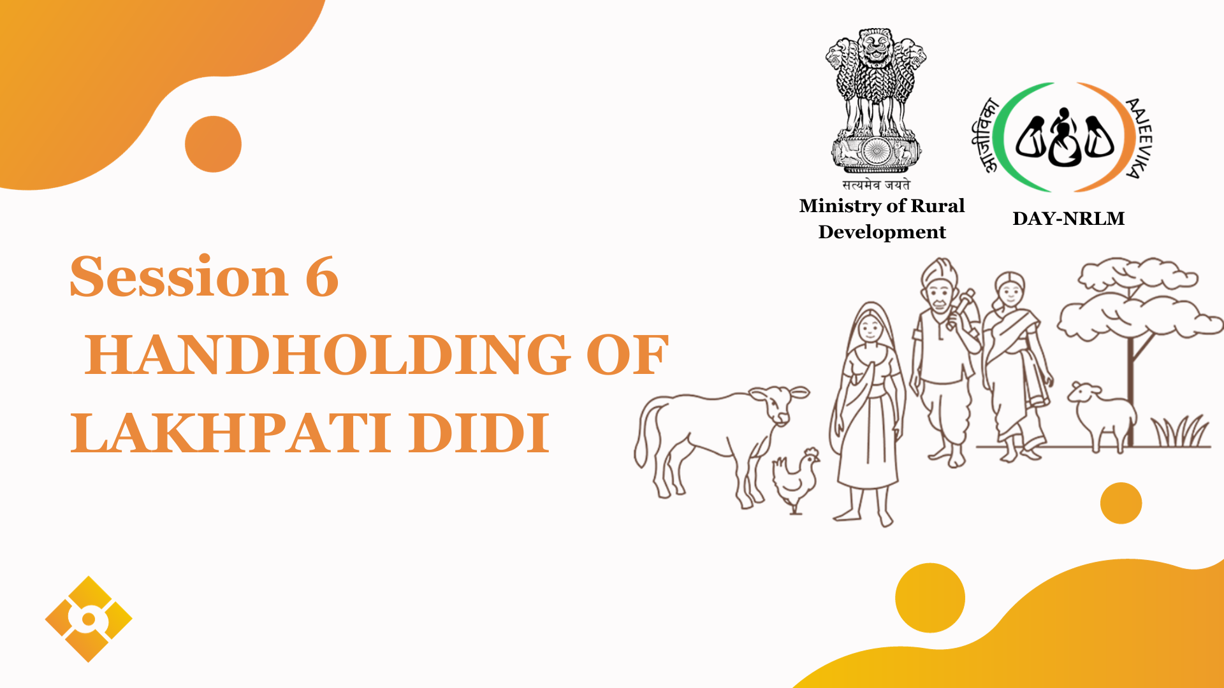
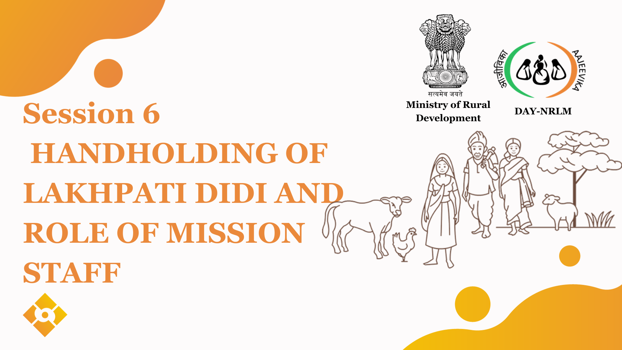
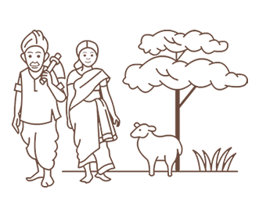
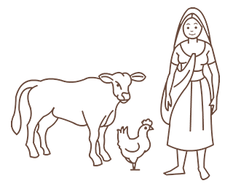
Session-6
Handholding of Potential Lakhpati Didis &
Roles of Stakeholders
Notes:
This section will focus on understanding the concepts and elements of sustainable livelihoods.

Slide 2
Overview
Introduction to Handholding
Strategies for Effective Hand holding
CRP level Activities & Expected Outcomes
Roles of CLFs and VO
Roles of SRLM

Slide 3

IMPORTANCE OF THE SESSION
Purpose:
  To prepare Lakhpati CRPs to handhold Potential Lakhpati Didis in the journey towards becoming Lakhpati
  Make them aware of the role and responsibilities of Stakeholders for facilitating them to be as mentor
Notes:
The Facilitator will pose a query against the participant, that how a household decides on the livelihood activity

Slide 4
Handholding of Lakhpati Didis
Need of handholding and Roles and Responsibilities of Lakhpati CRPs

Slide 5
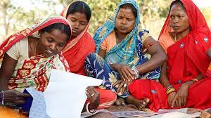
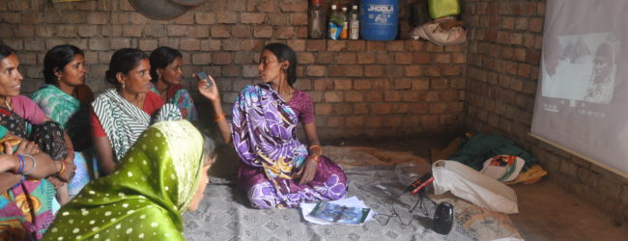
HANDHOLDING
Why??
Potential Lakhpati to Actual Lakhpati: Support throughout the journey.
How??
Personal Touch: Personalized guidance and its impact.
Beyond Financial Assistance and Linkages: Understanding that support is multi-dimensional.
Handholding
Strategies
CRP level activities
Roles of CLF,VO
Role of SRLM

Slide 6
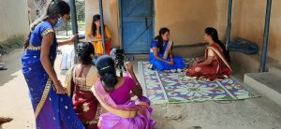
WHY HANDHOLD MATTERS
Understanding Ground Realities: Every Didi has a unique story.
Bridging Gaps: Addressing unmet needs, even might be unexpressed earlier
Ensuring Sustainability: Building a foundation for continued success.
Handholding
Strategies
CRP level activities
Roles of CLF,VO
Role of SRLM

Slide 7

Strategies for Effective Handholding
Individualized planning
Regular Check-ins
Individualized Planning: Recognizing and respecting unique needs
Empathy
Regular Check-ins: Monitoring progress, track connect with Didis, offering timely feedback
Empathy: Understanding Didi’s aspirations and fears
Handholding
Strategies
CRP level activities
Roles of CLF,VO
Role of SRLM
Notes:
The facilitator will link the previous responses with this slide and categorized the responses of the participants on the previous slide.

Slide 8
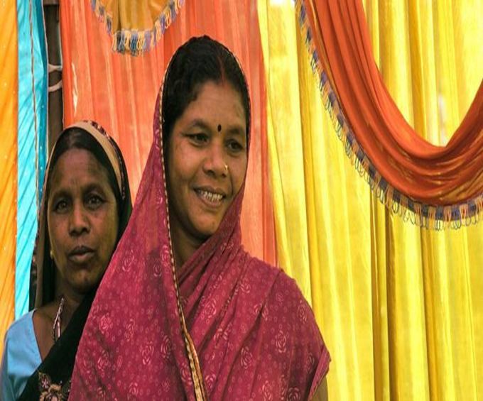
Reiterating CRPs Roles: Pillars of Continuous Support
Facilitator: Personalized guidance, tailored to each SHG member. Connect with schemes, progs, institutions
Troubleshooters: Navigating through challenges.
Capacity Builder: Enhancing skills and knowledge of Members
Monitoring : Continual oversight, course correction.
Handholding
Strategies
CRP level activities
Roles of CLF,VO
Role of SRLM

Slide 9
CRP’s ACTIVITIES & EXPECTED OUTCOME
Linkages for Asset building: Assisting in placing the demands in right forums and follow up.
  Outcome: Livelihood assets created at HH level
Skill Building: Market understanding, digital literacy, production risks, etc.
Outcome: Didis become more self-reliant and market-ready.
Financial Guidance: Assisting with schemes, subsidies.
  Outcome: Didis have robust financial backing.
Market Connect: Linking with PGs/ PEs / other business institutions
  Outcome: Didis' products/services are linked with broader market
Handholding
Strategies
CRP level activities
Roles of CLF,VO
Role of SRLM

Slide 10
CRP’s ACTIVITIES & EXPECTED OUTCOME….
Quality Control: Making Didis aware of Maintaining product/service standards, and market quality expectations
  Outcome: Long-term trust and demand for Didis' offerings.
Feedback Mechanisms: Platforms for Didis to voice concerns.
  Outcome: Continuous improvement and trust-building.
Networking: Connecting Didis with wider networks.
  Outcome: Didis benefit from collaborations, knowledge sharing
Handholding
Strategies
CRP level activities
Roles of CLF,VO
Role of SRLM

Slide 11
Roles of CLFs and VOs

Slide 12
Role of CLF in Lakhpati Planning
Post Planning
Review and analysis of Consolidated Livelihood Plans Identifying activities those can be supported through CLF /VO resources Ensuring resource availability for LH activities through CBO resources (RF/ CIF / etc) Submission of requests that can be materialised through line departments Coordination and follow-up with departments Monitor timely initiation and completion of works as per LH activities
Handholding
Strategies
CRP level activities
Roles of CLF,VO
Queries

Slide 13
VO’s Roles and Responsibilities
During Planning | During Implementation
Orienting SHGs about LH planning Consolidation of livelihood Plans at Village level Consolidating the supports & present in GS Get it integrated with AAP and GPDP for resources Coordinate with the Cluster Level Federation (CLF) | Monitor and facilitate the support and LH activity taking up Supervise, guide and facilitate the CRPs Follow up with the relevant departments /entity, if req. Track responsible entities for each approved plan
Handholding
Strategies
CRP level activities
Roles of CLF,VO
Queries
Notes:
The facilitator will link the previous responses with this slide and categorized the responses of the participants on the previous slide.

Slide 14
Roles of SRLM
At Block, District and State level

Slide 15
ROLE OF BLOCK LEVEL TEAM
Direct Interaction and Guidance: Regular interaction sessions and guidance to CRPs for addressing local issues.
Resource Provision: Ensure CRPs have the necessary resources and tools for their activities.
Local Training and Capacity Building: Provide training programs tailored to local needs to enhance CRPs' skills.
Feedback and Problem Resolution: Act as the first point of contact for feedback and resolution of challenges faced by CRPs.
Participate in livelihood planning at CLF level: The experts from Block unit participate in CLF meeting and support them in preparing action plan. Share the prepared plan to livelihood theme at district level.
Handholding
Strategies
CRP level activities
Roles of CLF,VO
Role of SRLM

Slide 16
ROLE OF DISTRICT LEVEL TEAM
Review the Livelihood plan prepared at CLF level and provide suggestions on the same.
Information and Resource Flow Management: Establish efficient information and resource distribution channels to ensure Block level teams and CRPs are well-equipped.
Developing Supportive Systems: Create and implement systems at the district level that facilitate the work of Block level teams and CRPs.
Feedback and Improvement Systems: Set up systems for collecting and analyzing feedback from Block level teams and CRPs to continually improve support mechanisms.
Collaboration and Partnership Development: Foster partnerships with local NGOs, government bodies, and other stakeholders to strengthen support systems for CRPs.
Technology Integration: Utilize technology to streamline processes and improve communication between district, block, and CRP levels.
Handholding
Strategies
CRP level activities
Roles of CLF,VO
Role of SRLM

Slide 17
ROLE OF STATE LEVEL TEAM
Policy Framework and System Alignment: Develop policies and align systems across the state to support the Lakhpati Didi initiative's objectives.
Resource Mobilization for System Development: Secure resources for the development and maintenance of systems that support district and block level teams.
Statewide System Coordination: Ensure consistency and coherence in systems across different districts to facilitate uniform support for CRPs.
Monitoring and Evaluation Systems: Implement state-level monitoring and evaluation systems to assess the impact of these support systems on the program's success.
Innovation and Best Practices: Encourage innovation in system development and share best practices across districts to continually enhance support to CRPs.
Handholding
Strategies
CRP level activities
Roles of CLF,VO
Role of SRLM

Slide 18
Queries and Observations?

Slide 19
Thank you

